Slide 1
Eliciting Security Requirements
Dr Mu Yang
COMP6236 - Software Engineering and Cyber Security

Slide 2
Last Week
General security risk analysis concepts and process
CORAS
Graphical language (diagrams)
Process to identify and prioritize security risks

Slide 3
Today
Why Security Requirements?
What are Security Requirements?
How do we elicit Security Requirements?
Misuse Cases
Attack Trees
Exercise
Create Misuses Cases for Online Shop

Slide 4
Learning outcomes
By the end of today’s lecture you should be able to:
Differentiate between functional and security requirements
Compare use cases and misuse cases
List and identify misuse cases

Slide 5
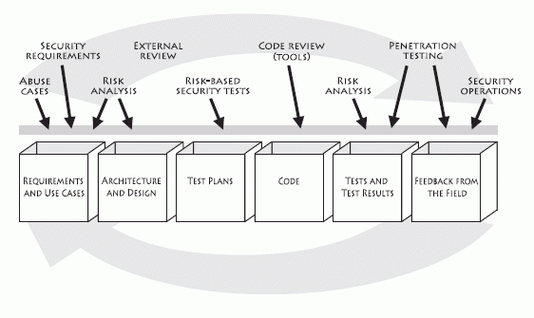
Security Requirements

Slide 6
Security Requirements
It is very difficult and expensive to improve security at late stages of SDLC.

Slide 7
Security Requirements
It is very difficult and expensive to improve security at late stages of SDLC.
Introducing secure engineering practices early in the SDLC brings the highest rate of return.

Slide 8
Security Requirements
What the system should NOT be able to do

Slide 9
Security Requirements
What the system should NOT be able to do
Must take the attacker perspective

Slide 10
Security Requirements
What the system should NOT be able to do
Must take the attacker perspective
Should be explicitly stated so that these requirements can be tested as often as possible

Slide 11
Security Requirements
What the system should NOT be able to do
Must take the attacker perspective
Should be explicitly stated so that these requirements can be tested as often as possible
Should not be stated separately from functional requirements nor be boilerplate security requirements.
Bad example: a system should use firewall.
Good example: a system should protect against DoS attacks in order to fulfil its mission.

Slide 12
Security Requirements
What the system should NOT be able to do
Must take the attacker perspective
Should be explicitly stated so that these requirements can be tested as often as possible
Should not be stated separately from functional requirements nor be boilerplate security requirements.
Should be done iteratively

Slide 13
Functional vs Security Requirements
Functional requirements
Functions that the system must perform
e.g. Doctor has ability to update patient records
Security requirements
Constraints on the functions of the system, where the constraints operationalize one or more security goals
e.g. Transactions involving personal health information must be logged (integrity and confidentiality - security goals)

Slide 14
Functional vs Security Requirements
Functional requirements
Functions that the system must perform
e.g. Doctor has ability to update patient records
Security requirements
Constraints on the functions of the system, where the constraints operationalize one or more security goals
e.g. Transactions involving personal health information must be logged (integrity and confidentiality - security goals)
Impact on performance

Slide 15
Examples of Security Requirements
All sensitive data must be sent in encrypted form.
(confidentiality)
Servers that untrusted users access must use signed certificates by a recognized Certification Authority. (authenticity)
An automatic logout during session inactivity must occur
(authenticity)
The system shall provide Personnel Information only to members of Human Resources Dept. (confidentiality)

Slide 16
Examples of Security Requirements
All sensitive data must be sent in encrypted form.
(confidentiality)
Servers that untrusted users access must use signed certificates by a recognized Certification Authority. (authenticity)
An automatic logout during session inactivity must occur
(authenticity)
The system shall provide Personnel Information only to members of Human Resources Dept. (confidentiality)

Slide 17
Examples of Security Requirements
All sensitive data must be sent in encrypted form.
(confidentiality)
Servers that untrusted users access must use signed certificates by a recognized Certification Authority. (authenticity)
An automatic logout during session inactivity must occur
(authenticity)
The system shall provide Personnel Information only to members of Human Resources Dept. (confidentiality)

Slide 18
Examples of Security Requirements
All sensitive data must be sent in encrypted form.
(confidentiality)
Servers that untrusted users access must use signed certificates by a recognized Certification Authority. (authenticity)
An automatic logout during session inactivity must occur
(authenticity)
The system shall provide Personnel Information only to members of Human Resources Dept. (confidentiality)

Slide 19
Use Cases
Describe what a system/software SHOULD DO
Specify a type of complete interaction between a system/ software and one or more actors
Actors represent entities outside the system that interact with it in some way
Association
Use Case
Actor

Slide 20
Use Cases
Describe what a system/software SHOULD DO
Specify a type of complete interaction between a system/ software and one or more actors
Actors represent entities outside the system that interact with it in some way
Association
Use Case
Actor
Human actor
Non-human actor

Slide 21
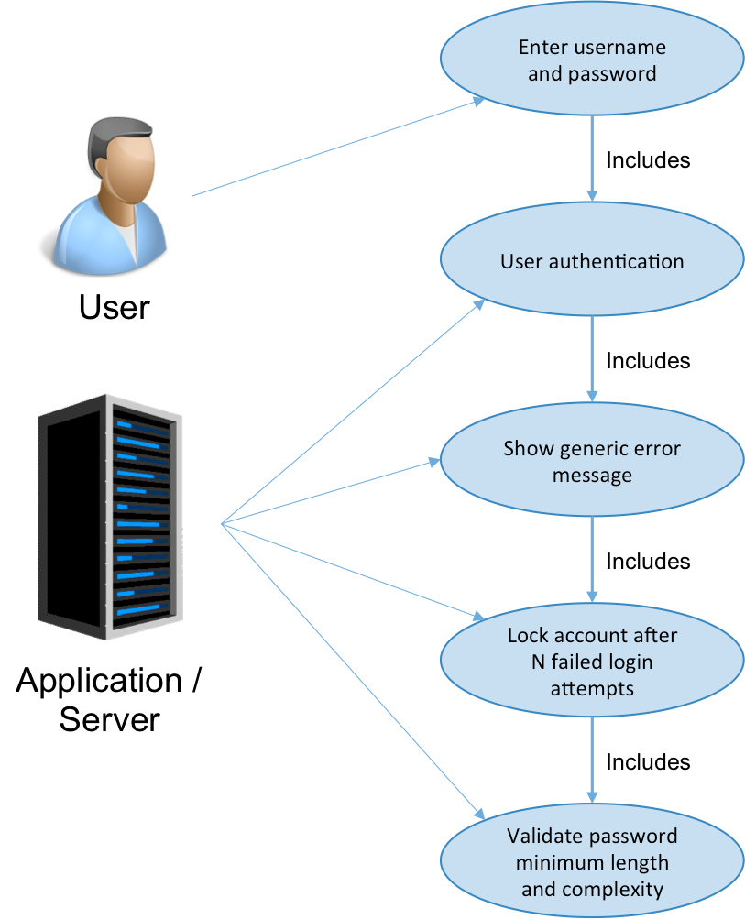
A Use Case
10

Slide 22
A Use Case
User authentication
Show error message
10

Slide 23
Elicitation Methods and Techniques
Techniques
Misuse/Abuse Cases
Attack Trees
Processes
SQUARE
SREP
CLASP
SECURE TROPOS
KAOS

Slide 24
Misuse Cases
Tool for helping to think about software the same way attackers do

Slide 25
Misuse Cases
Tool for helping to think about software the same way attackers do
Use case is a function the system SHOULD do
Misuse case is a function the system SHOULD NOT allow

Slide 26
Misuse Cases
Tool for helping to think about software the same way attackers do
Use case is a function the system SHOULD do
Misuse case is a function the system SHOULD NOT allow
Specify a type of complete interaction between a system and one or more actors, where the results or the interaction are harmful to the system, one of the actors or one of the stakeholders of the system

Slide 27
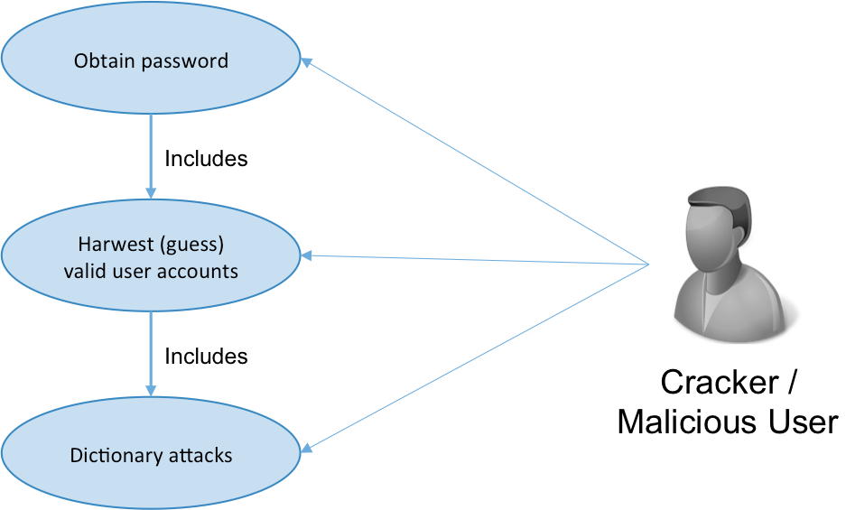
An Misuse Case

Slide 28
Building Misuse Cases
Start from a normal use case model
Identify actors (attackers/misuser)
- What skills the attacker has?
- What resources the attacker has ?
- What does the attacker want to achieve?
Identify the Misuse cases
- What can a bad guy do?

Slide 29
Building Misuse Cases (Cont.)
Identify threaten relationships between use cases and misuse cases
Identify security use cases a.k.a security requirements

Slide 30
Misuse Cases
Misuse Case
Misuse Case
A sequence of actions, including variants that a system or other entity can perform, interacting with misusers of the entity and causing harm to some stakeholder if the sequence is allowed to complete
Misuser
An actor that initiates misuse cases either intentionally or inadvertently
Use cases and misuse cases are shown in the same diagram
Misuser

Slide 31
Misuse Cases
Relationships between use cases and misuse cases
Mitigate
Threaten

Slide 32
Misuse Cases
Relationships between use cases and misuse cases
Mitigate
Threaten
The use case is exploited or hindered by the a misuse

Slide 33
Misuse Cases
Relationships between use cases and misuse cases
Mitigate
The use case is a countermeasure against a misuse case
Threaten
The use case is exploited or hindered by the a misuse

Slide 34
Misuse Cases
Relationships between use cases and misuse cases
Mitigate
The use case is a countermeasure against a misuse case
The use case is the security requirement
Threaten
The use case is exploited or hindered by the a misuse

Slide 35
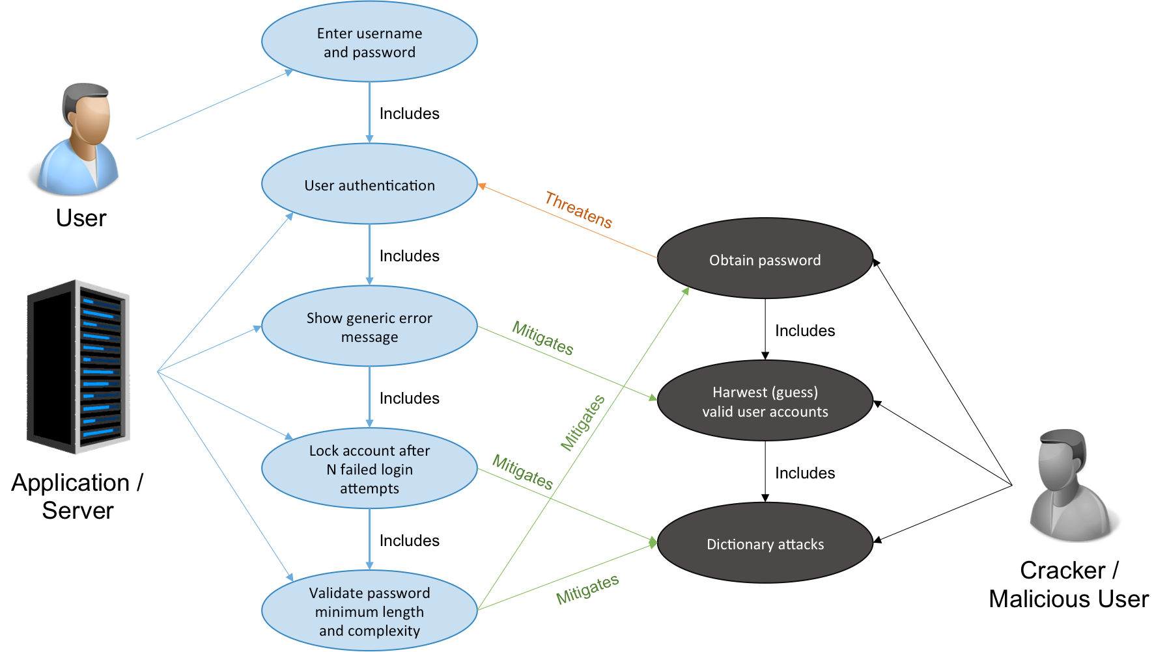
A Misuse Case

Slide 36
A Misuse Case
Security Use Case
a.k.a. Security requirements

Slide 37
Misuse Case Template
Name: Obtain Password
Summary: Hacker obtains and misuse user password
Basic Path
bp0 An hacker has hacked a network host computer and installed an IP packet sniffer (step bp0-1.) All sequences of messages sent through the compromised host and which contain strings like 'Logon', 'Username', 'Password', 'passwd' etc. are intercepted and analysed further (step bp0-2 and extension point e1.) In this way, the hacker collects (likely) user names and passwords along with the IP addresses of the computers they are valid on (step bp0-3.) The hacker- possibly much later - uses the user name and password to gain illegal operator access to web application(step bp0-4.)

Slide 38
Misuse Case Template
Alternative paths
ap1 The Hacker has operator privileges on the network host.
Capture Points
cp1 The password does not work because it has been changed cp2 The password does not work because it is expired Extension Points
Triggers tr1 Always true

Slide 39
Misuse Case Template
Preconditions:
pc1 The system has a special user 'operator' with extended authorities. pc2 The system allows the operator to log on over the network.
Assumptions
as1 The operator uses the network to log on to the system as operator (for all paths.)
Worst case threat (postcondition):
wc1 The hacker has operator authorities on the web app for an unlimited time, i.e., she is never caught.
20

Slide 40
Misuse Case Template
Capture guarantee (postcondition):
dcg1 The hacker never gets operator authorities on the web app.
Related business rules:
br1 The role of web app operator shall give full privileges on the web app, the web app computer and the associated local network host computers.
br2 Only the role of e-shop system operator shall give the privileges mentioned in br1.
Potential misuser profile: Highly skilled, potentially host administrator with criminal intent.

Slide 41
Misuse Case Template
Stakeholders and threats:
sh1 company
reduced turnover if misuser uses operator access to sabotage system
sh2 customer
loss of privacy if misuser uses operator access to find out about customer’s shopping habits
Scope: Entire business and business environment.
Abstraction level: Misuser goal.

Slide 42
Attack Trees
Proposed by Bruce Schneier, 1999
Used for threat modelling, security requirements elicitation
It focuses on the attackers and the different ways they may try to attack systems.

Slide 43
Attack Trees
Root of the tree represents the attack goal.
Branches in the tree represent the different paths an attacker can follow to achieve his/her goal.
Two possible attack decompositions:
AND-decomposition: All subgoals must be fulfilled in order for the parent attack to succeed.
OR-decomposition: At least one of the subgoals must succeed for the parent attack to succeed

Slide 44
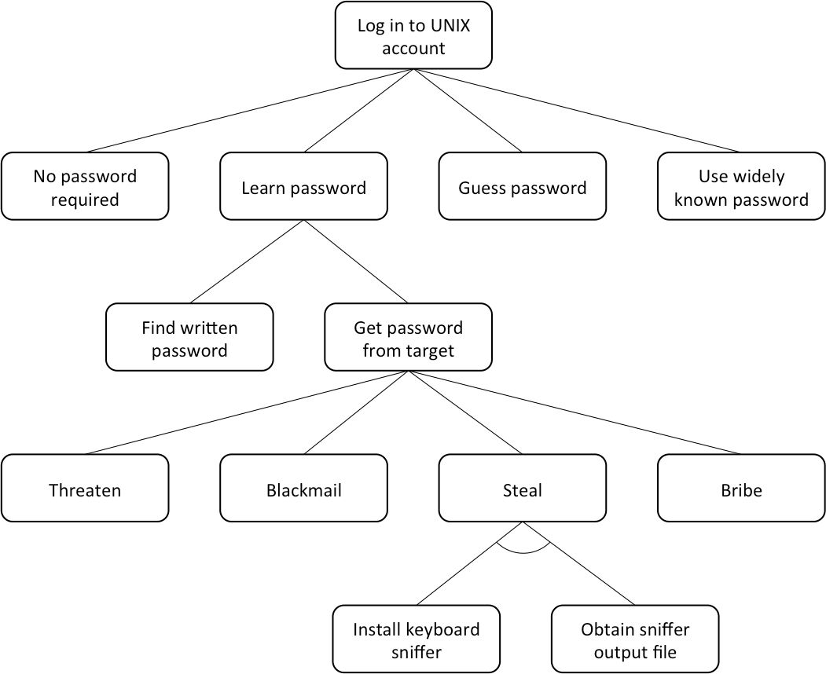
An Attack Tree

Slide 45
Building Attack Trees
Identify top level attacks against the system
Brainstorm for different ways these attack can be achieved
– specify children attacks recursively, until the way of performing each attack is obvious so that further decomposition not useful

Slide 46
Summary
Security requirements are constraints on the functions of the system, where the constraints operationalize one or more security goals
To identify security requirements you have to think about the software as an attacker would do
Misuse cases help to identify how a system can be misused or Misused
Attack trees help to identify all the possible ways in which an attack can be performed

Slide 47
Small task
Think about the strengths of Misuse Case and Attack Tree, do we need both for eliciting security requirements

Slide 48
Reading Material
Gary McGraw. Software Security. Building Security In. Chapter 8.
John McDermott , Chris Fox. Using Misuse Case Models for Security Requirements Analysis. Proceedings of the 15th Annual Computer Security Applications Conference, 1999.
Guttorm Sindre, Andreas L. Opdahl. Eliciting security requirements with misuse cases. Requirements Engineering Journal,2005.
Guttorm Sindre, Andreas L. Opdahl. Templates for Misuse Case Description. Proceedings of Requirements Engineering: Foundations for Software Quality, 2001.

